Slide 1

Machine learning
Prabindh Sundareson
Ieee Consumer electronics society, bangalore chapter
Srm institute, April 2018
IEEE CE Society
SRM Institute, Apr 2018

Slide 2
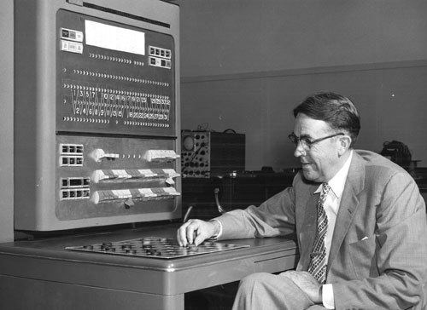
||| Warm up |||
Identify who, and context
Arthur Samuel
2. The most popular site for ML competitions:
Google
Kaggle
Microsoft
Hacker rank
What is ML

Slide 3
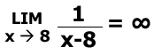
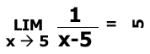
So what is machine learning ?
What it is not:
A brand new technology developed in 2012
What is it ? Is the below “machine learning” ?
➔ Thus,
http://oneweirdkerneltrick.com
Don’t miss this site !
IEEE CE Society
https://xkcd.com/1838/
What is ML
SRM Institute, Apr 2018

Slide 4
What is “the machine” learning ?
Given a [data-set] & [goal], [learn] a [compact] representation
Application
Sensors
Update
Algorithms
Frameworks
Optimisation
Algorithms
Triangle analogy

Slide 5


Simple analogy – representation
Foundations

Slide 6
Foundations of machine learning
Algorithms &
Frameworks
Hardware
Applications
HW

Slide 7
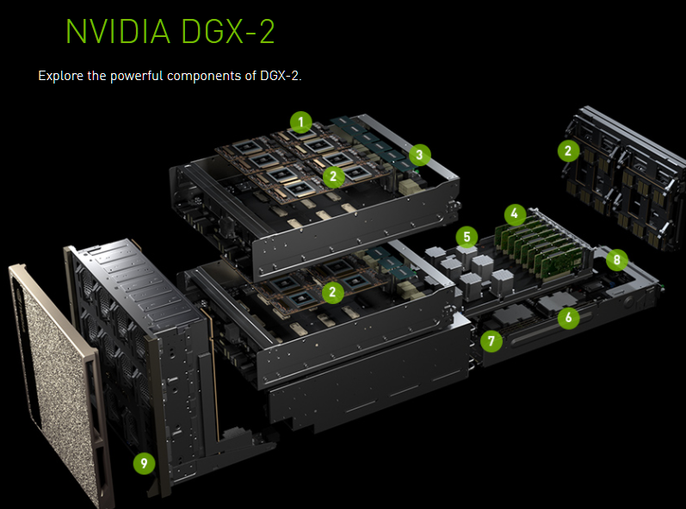
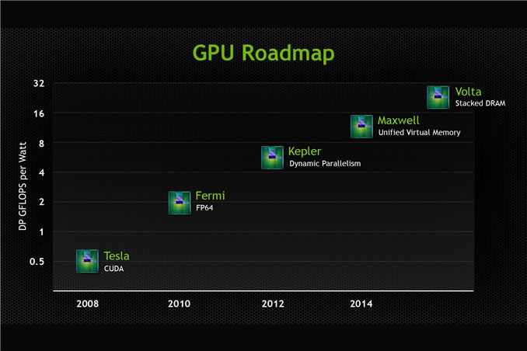
Machine learning – hardware progression
Others:
TPU, FPGA, Nervana, Movidius
Frameworks

Slide 8




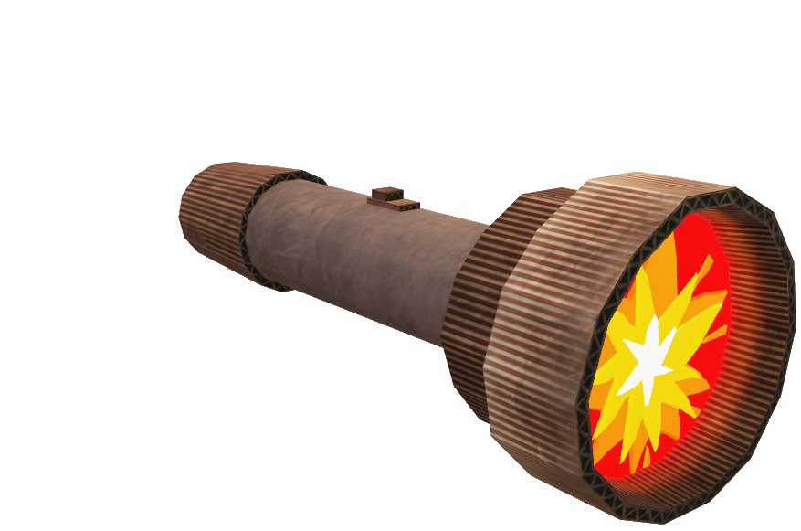
machine learning – Frameworks
For Developers, Researchers
CNTK
Gluon
R
Python
C++
Scala
Torch
Caffe
Keras
Pandas
Scikit learn
TensorFlow
dl4j
Darknet
Cloud

Slide 9
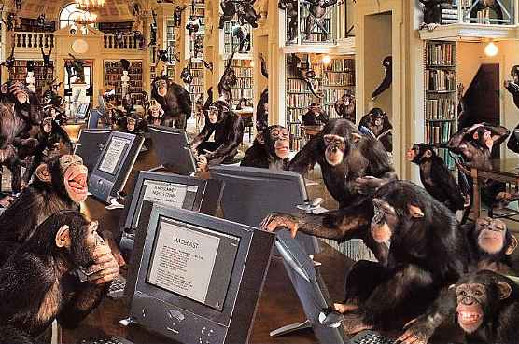
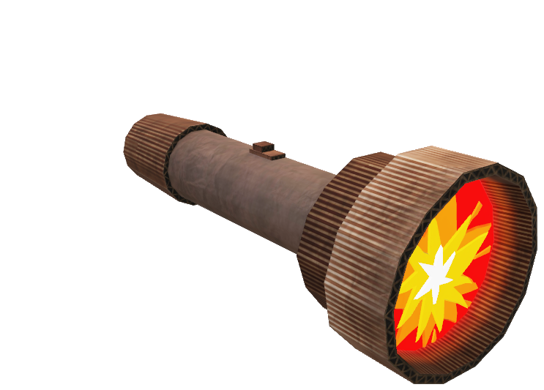
machine learning - cloud
For users
CNTK
Gluon
API
Keras
Pandas
Caffe
Torch
Scikit learn
Darknet
dl4j
TensorFlow
IEEE CE Society
Algorithms
SRM Institute, Apr 2018

Slide 10
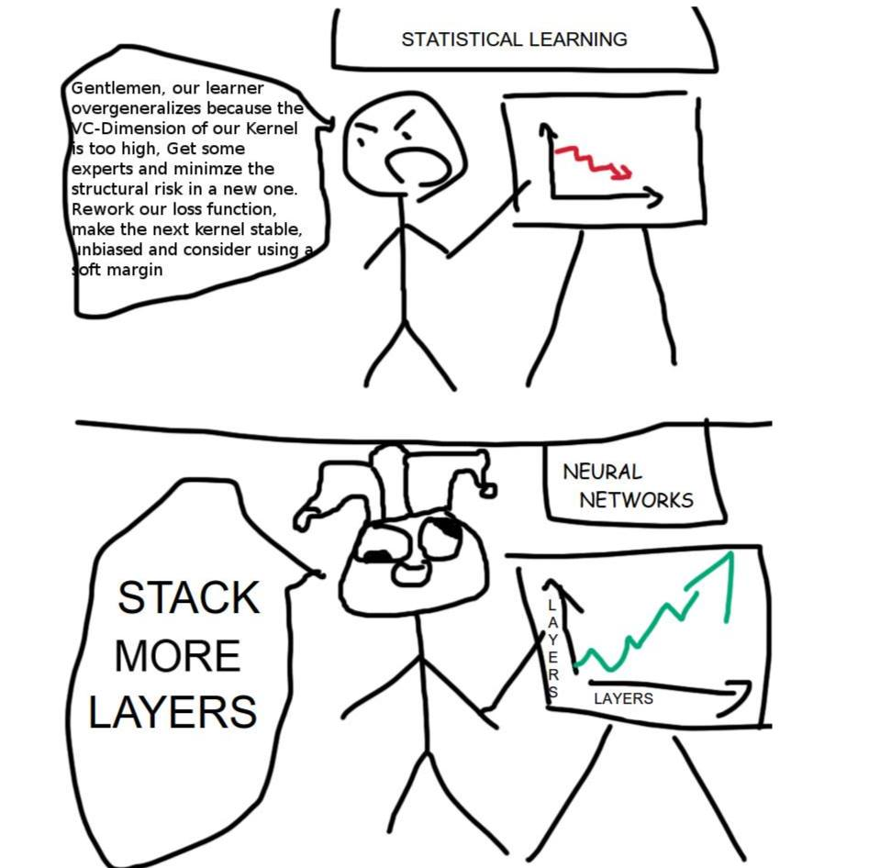
Machine learning - algorithms
Classical
Hand-coded features (skin color, angle of edges, …)
Clustering, Trees, …
Deep Learning
Automatic feature learning
Modular Training by algorithms
What are the challenges ?
IEEE CE Society
SRM Institute, Apr 2018
Challenges - HW

Slide 11
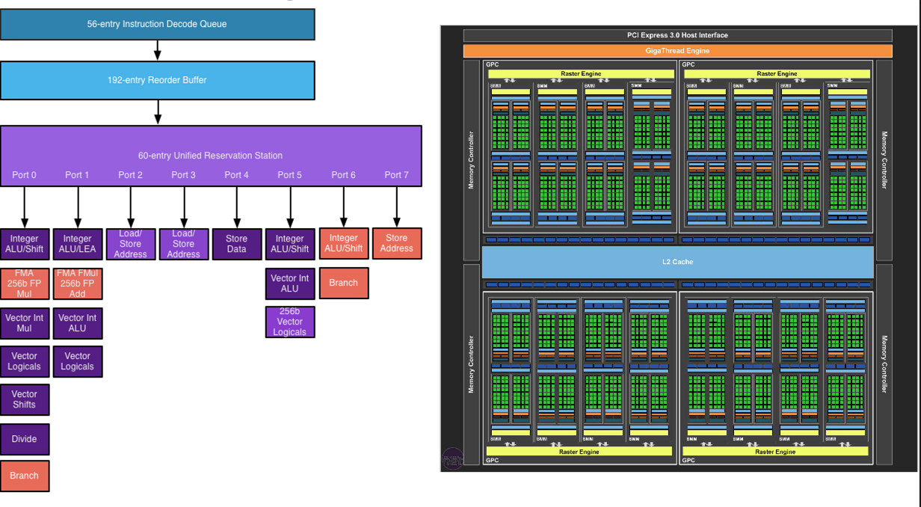
Machine learning – HW challenges
Moore’s law on economics of electronics
Performance ~ doubles every ~2 years
Limitations of architectures
Data throughput challenges
Data volume doubles every ~1.5 years
Impacts High Performance Computing (HPC)
Low power inference key for mobile devices
https://www.quora.com/in/Does-Moores-law-apply-to-GPUs-Or-only-CPUs
Provability

Slide 12
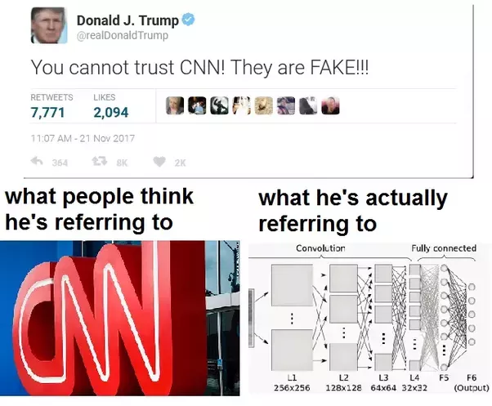
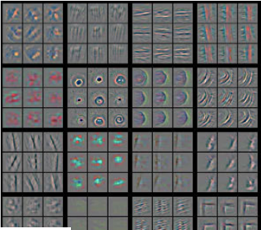
Challenges – algorithms - PROVABILITY
Why ? Not how
Role of non-linearities
Limits of ML

Slide 13
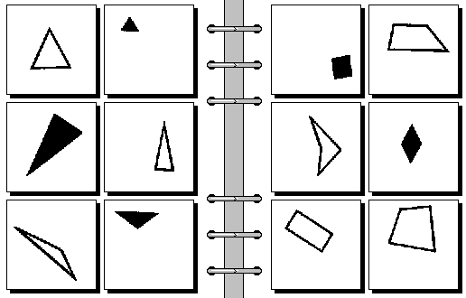
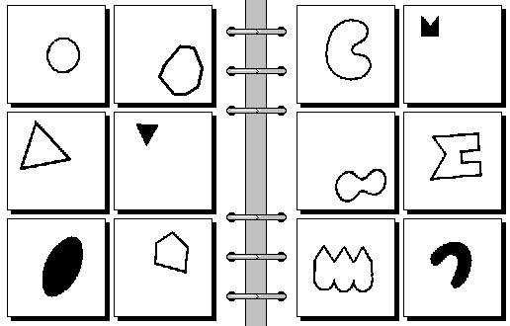
Limits of machine learning – where are we ?
Bongard problems
Harry Foundalis
Part 3 - Indian Context

Slide 14
Ml in the Indian context
4 cases
Language

Slide 15
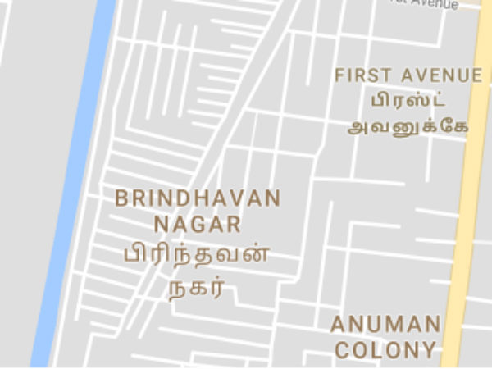
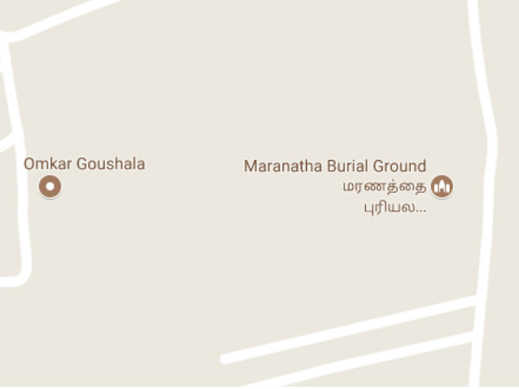
The Indian context 1 - language
Impact – 1Billion people
Language modelling
Translation
Recognition
IEEE CE Society
Medicine
SRM Institute, Apr 2018

Slide 16
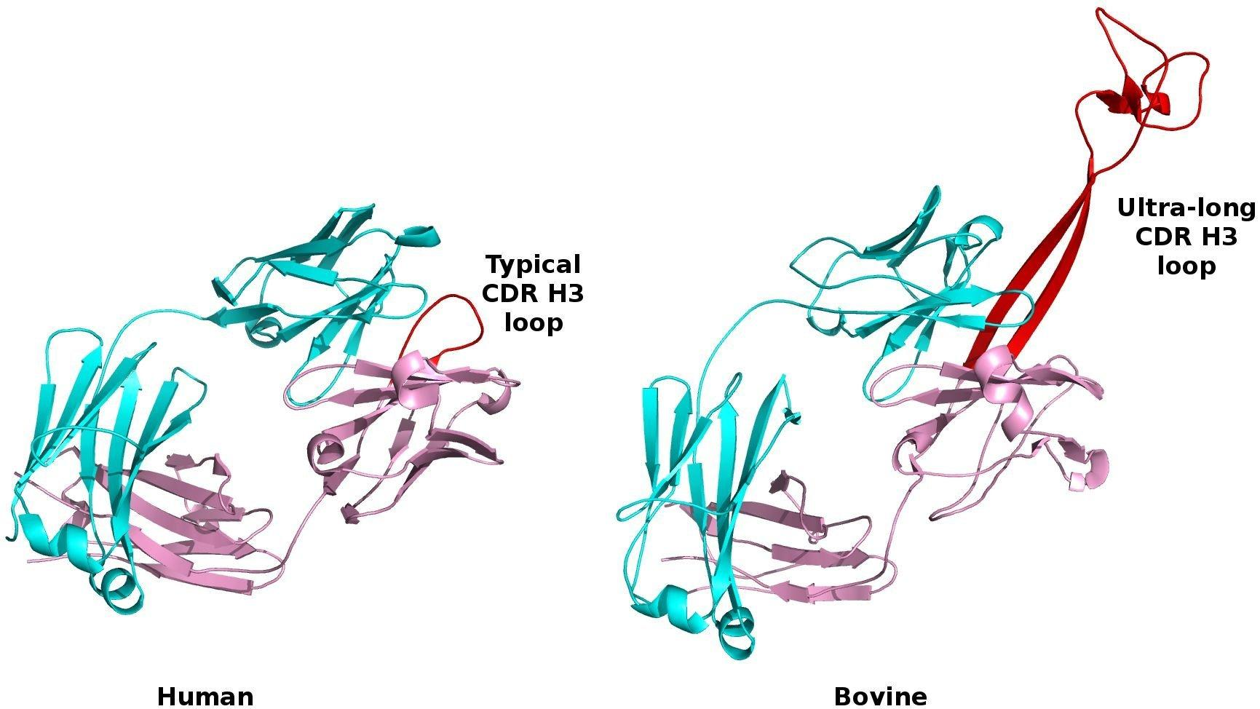
The indian context 2 - Medicine
Impact – x million people
Genus of cattle
Understanding the structure of the gene
Cattle - Only genus capable of Ultralong HCDR3 of 60 amino acids
Allows ABs to reach vulnerable regions of a virus, to break it down
Bos
B.Taurus
CDR - Complementarity-determining regions, From Cell Journal
BNAB – Broadly Neutralizing ABs
Privacy

Slide 17
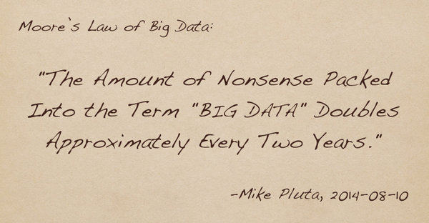
The Indian context 3 – data privacy
Apollo Hospitals (1L +)
Naukri.com (1L +)
Facebook (1B ?)
“Data is the new oil”
Privacy should be built into every algorithmic design
Quality of life

Slide 18
The indian context 4 – QUALITY OF LIFE
Water (Rain, ground water) conservation, monitoring
Fuel, Electricity
Jobs
Safety (Robotics)
More data available for research, can result in better predictions
IEEE CE Society
Summary
SRM Institute, Apr 2018

Slide 19
SUMMARY OF Challenges in ML
Differentiating very large number of classes (1000s ..)
Accuracy vs Power trade offs
Conversion of serial-in-nature algorithms to Parallel algorithms
Database queries
Take advantage of Moore’s law !
Availability of Unbiased, Labelled data-sets
Big challenge in Indian context !
Language/ context correctness
Provability of ML results
Training time
IEEE CE Society
SRM Institute, Apr 2018

Slide 20
Call for action
Identify relevant problems
Think big. Scale matters
Join local research communities
Give back, and change the world
Questions ? Ideas to discuss ? Contact.
Prabindh.Sundareson@gmail.com

